Slide 1


The Sky is the Limit
with the
and
Transitions Lifestyle System

Slide 2


“Red Hot and Rolling” across the Globe
The
^{AND} LIFESTYLE
2016 Jan-Dec | 2017 Jan-Dec | 2018 Jan-June
USD $21,811,186 | USD $22,394,404 | USD $20,874,522

Slide 3
2018 estimated TLS sales
more than USD $40,000,000
translates into more than
>60,000,000 BV !!!!!

Slide 4







Let’s look at our Market America Global Markets and who is leading the way Year to Date in TLS production over 2017 *.
Australia up 12%
United States up 15%
Canada up 26%
United Kingdom up 48%
Hong Kong up 117%
Singapore up 140%
Taiwan up 180%
*Malaysia Market just opened, Mexico no increase

Slide 5



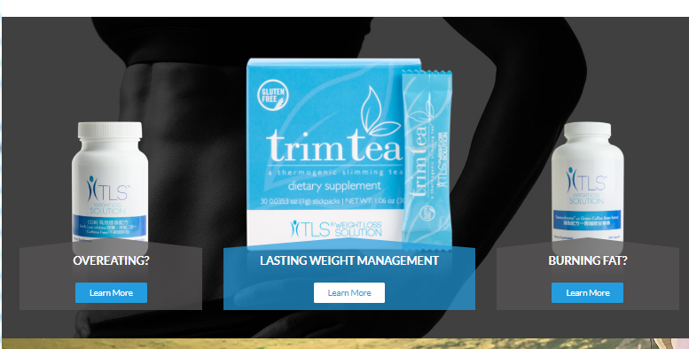

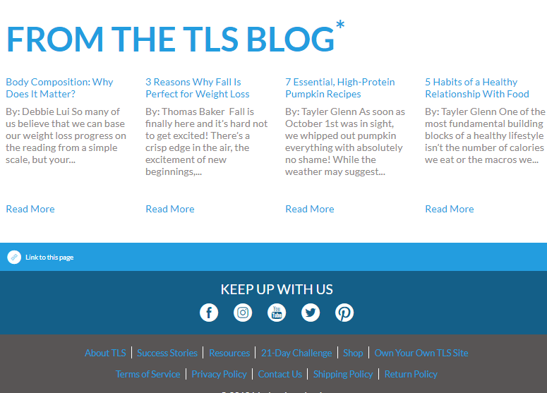
TOOLS TO USE
Website: HK.TLSSLIM.COM
TLS Products Flyers
Menu Plans
Recipes
Educational Video
Testimonials
Weight Loss Profile

Slide 6
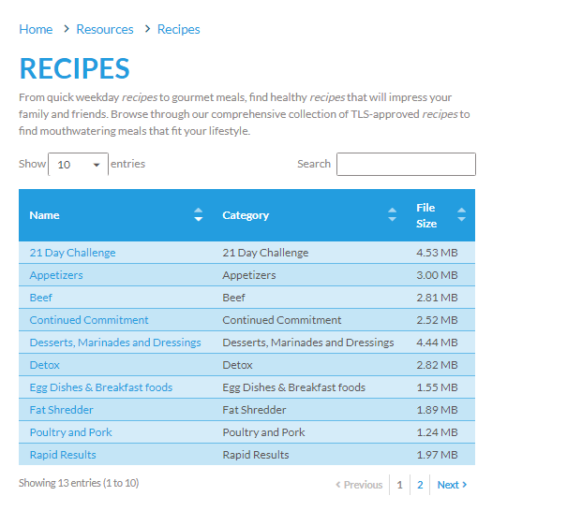
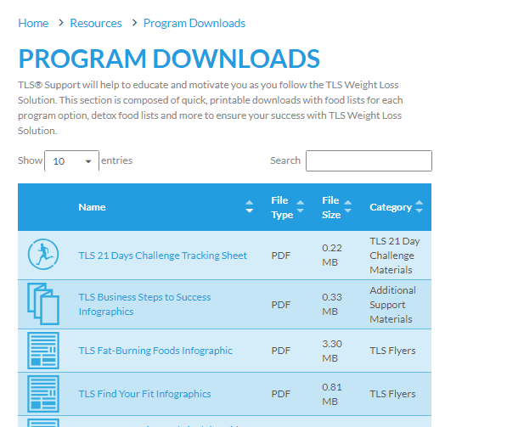

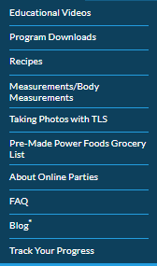
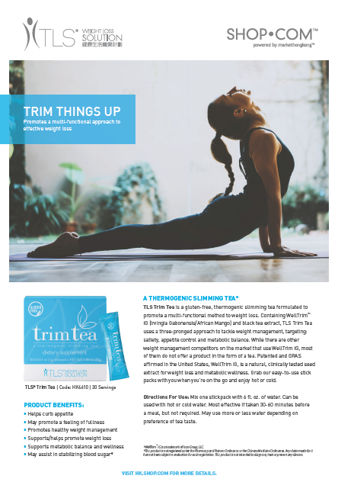

TOOLS TO USE
Website: HK.TLSSLIM.COM
TLS Products Flyers
Menu Plans
Recipes
Educational Video
Testimonials
Weight Loss Profile

Slide 7
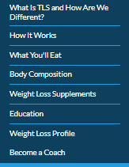
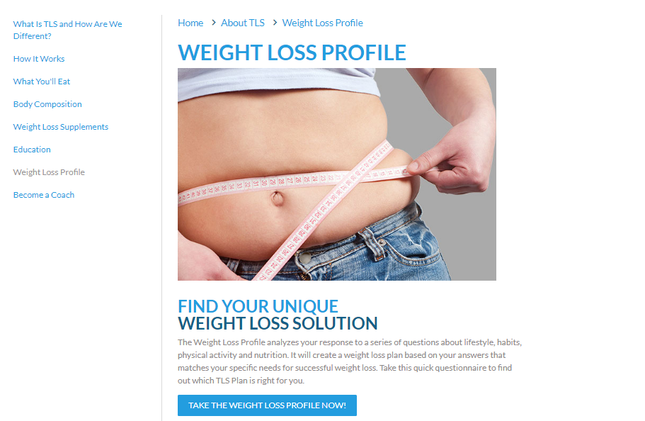
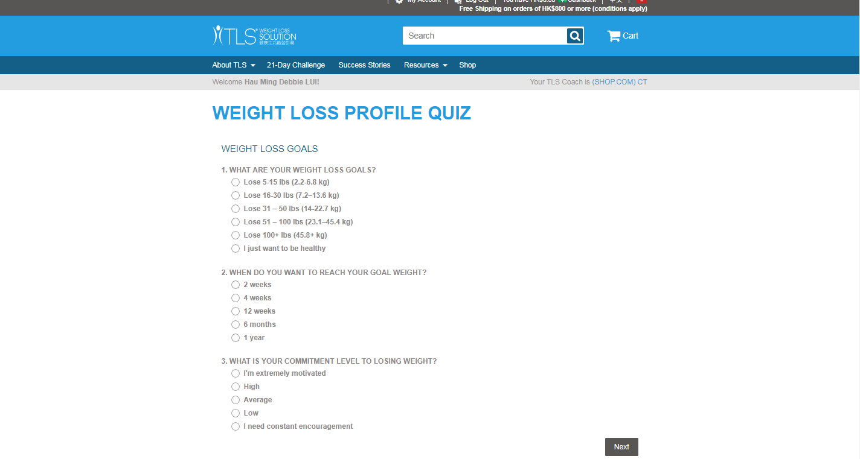



TOOLS TO USE
Website: HK.TLSSLIM.COM
TLS Products Flyers
Menu Plans
Recipes
Educational Video
Testimonials
Weight Loss Profile
TLS Weight Loss Profile

Slide 8
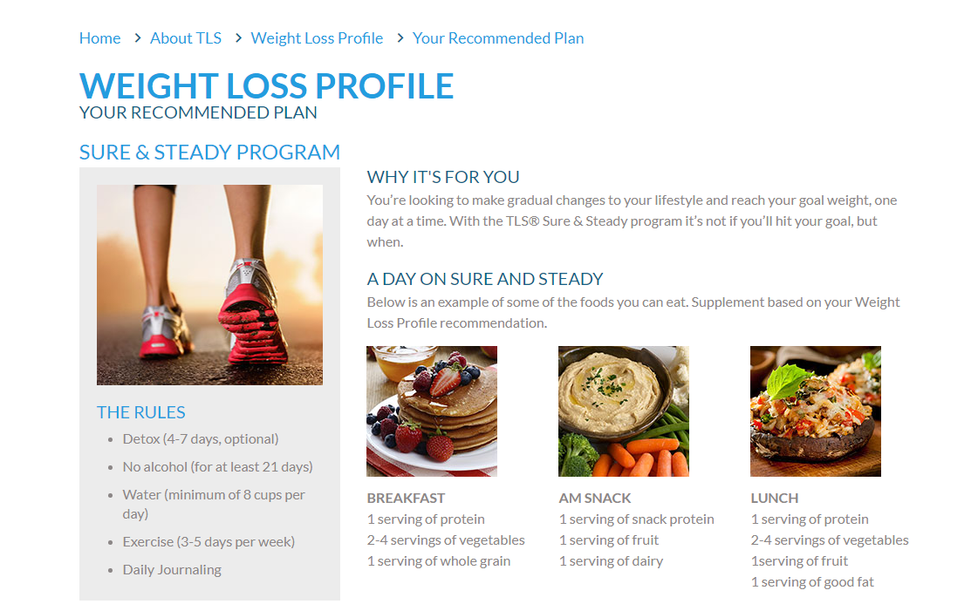
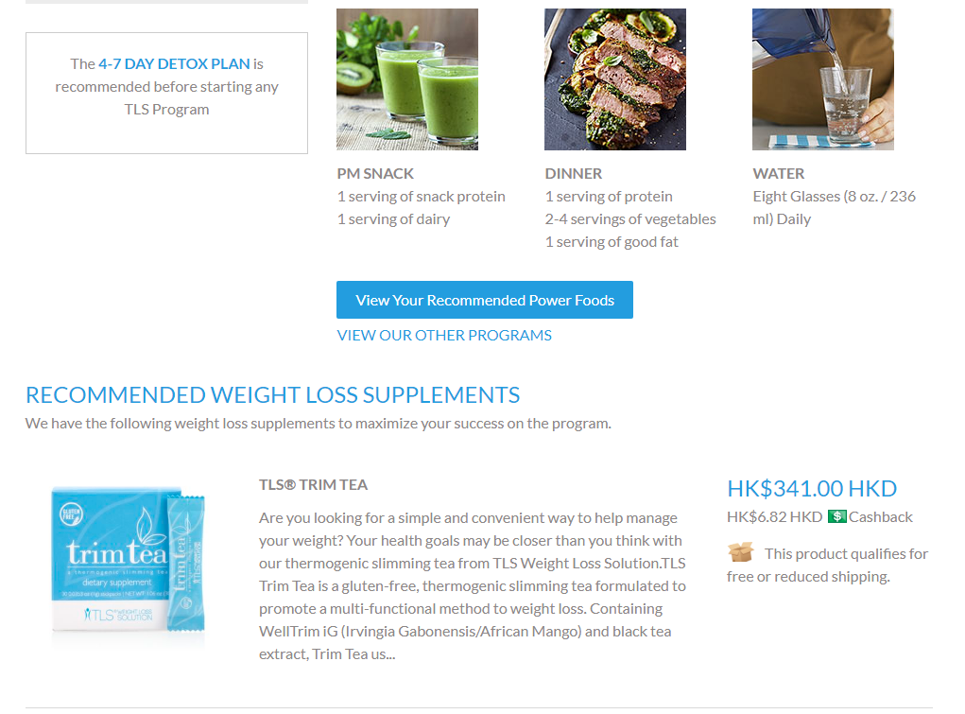
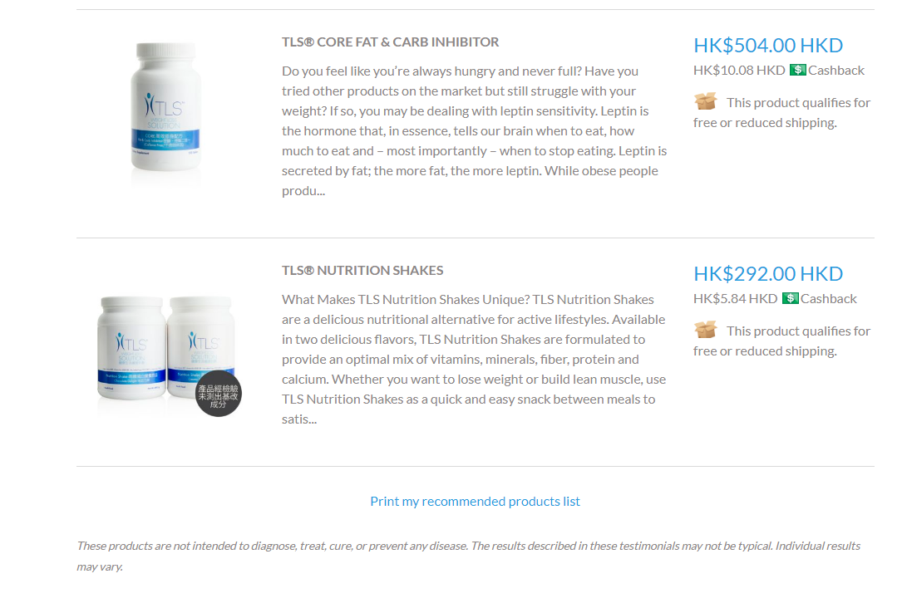
TOOLS TO USE
Website: HK.TLSSLIM.COM
TLS Products Flyers
Menu Plans
Recipes
Educational Video
Testimonials
Weight Loss Profile
TLS Weight Loss Profile

Slide 9
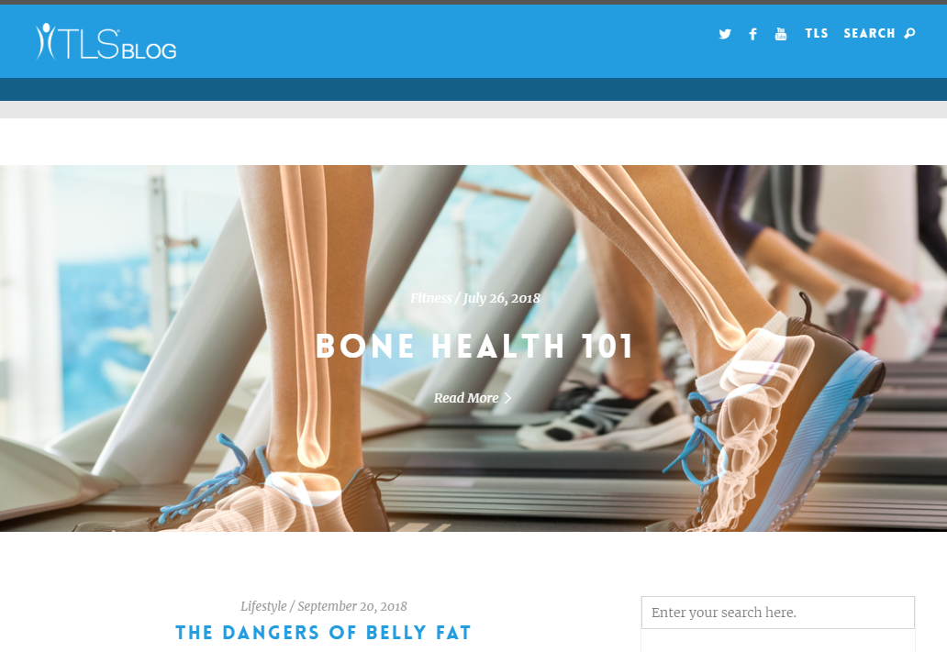
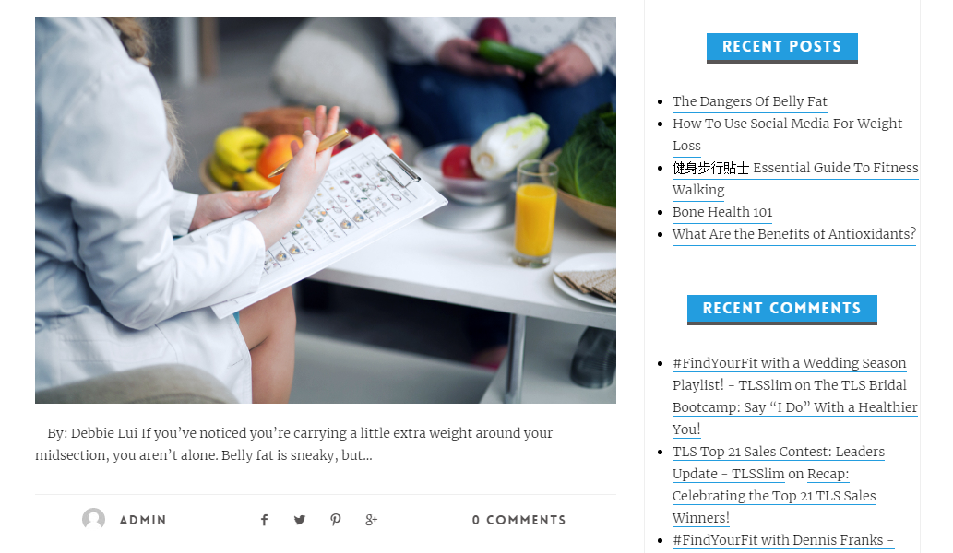
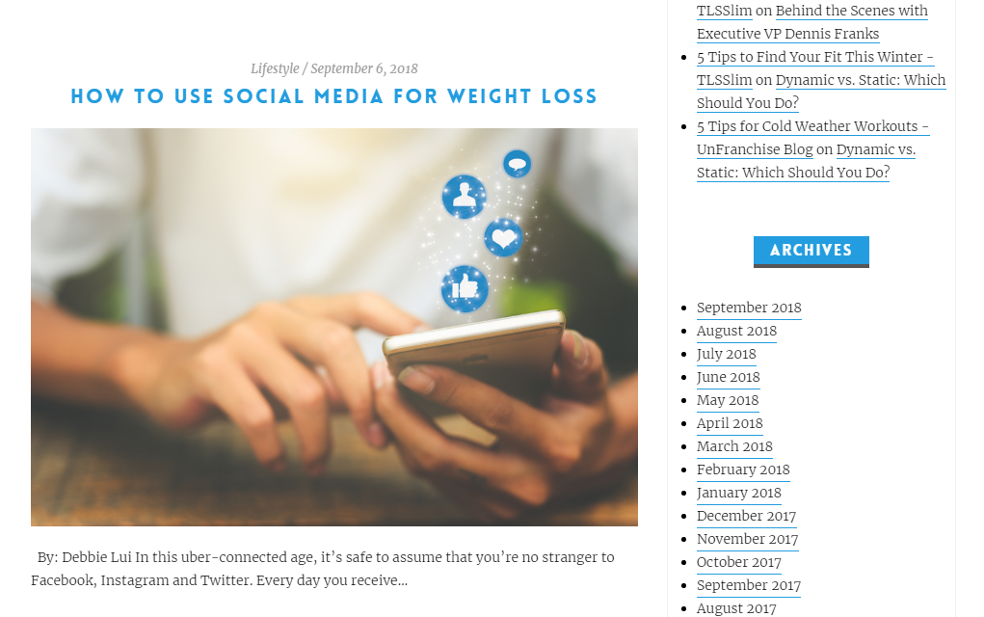

TOOLS TO USE
HKBlog.tlsSlim.com
Blog post include:
Health, exercise, weight loss, recipe and eating tips.

Slide 10
The Sky is the Limit
with the
and
Transitions Lifestyle System

Slide 11

The 4 Components of TLS®...
Low-glycemic Impact Eating
Supplementation
Body Composition
Education

Slide 12
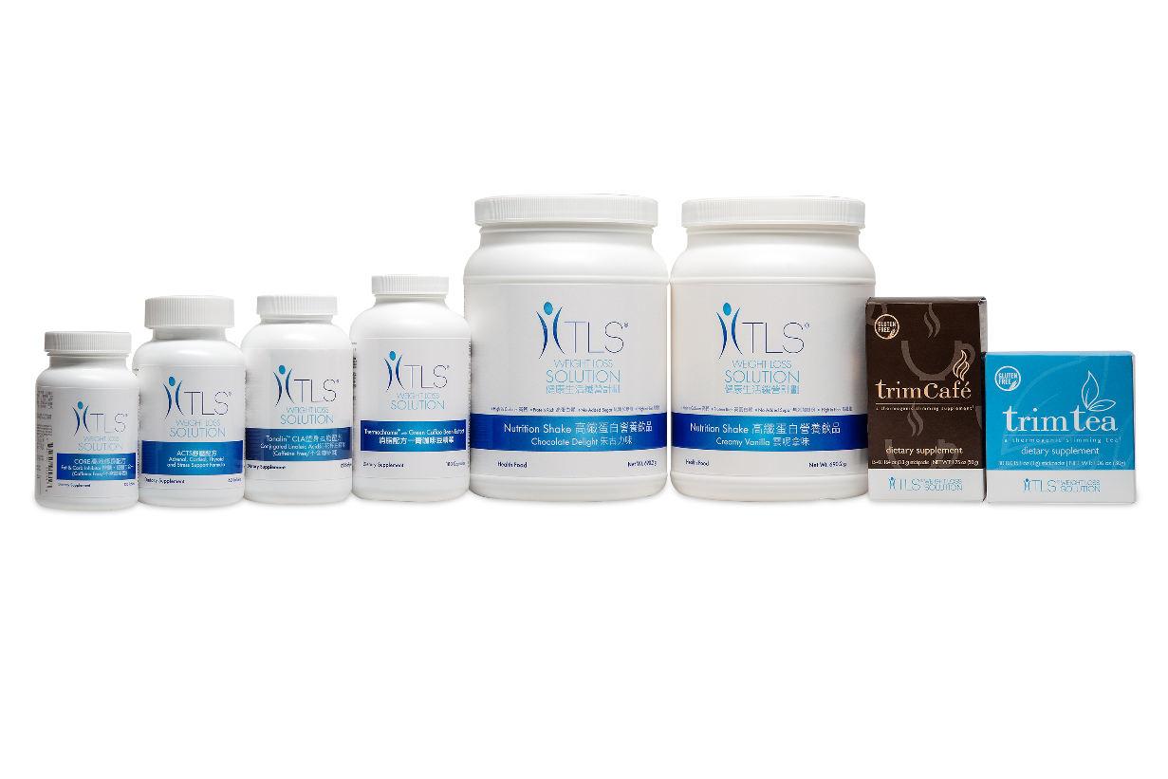
Quick TLS® Supplement Fact
Why Supplements...
Designed to support a new healthy lifestyle
  Poor Dietary Habits
  Support Hormone Balance
  Carbohydrate Sensitivity
  Chronic Stress and Fatigue
  Metabolism Support
  Burn Fat

Slide 13


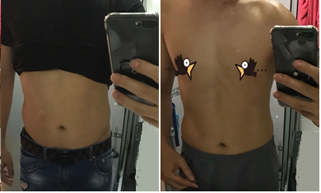





Reviews
6 WEEKS EXPERIENCE
7 WEEKS EXPERIENCE

Slide 14


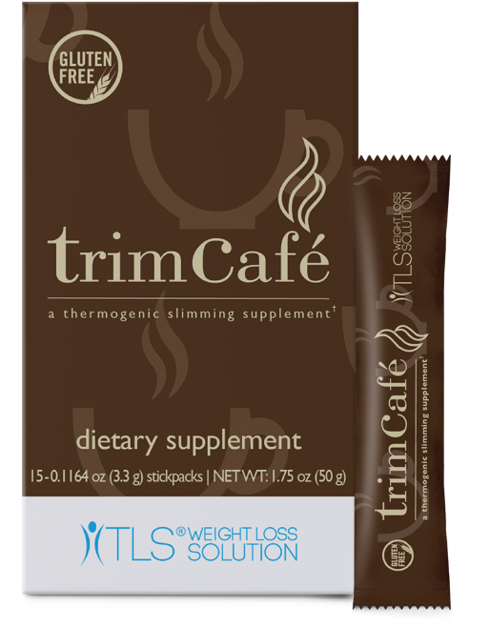

Slide 15


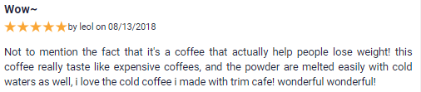

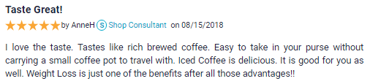
Reviews

Slide 16



Health Benefits:
Helps curb appetite
May promote a feeling of fullness
Promotes healthy weight management
Supports metabolic balance and wellness
Moderates glycerol-3-phosphate dehydrogenase enzyme activity to reduce the amount of ingested starches that are converted to triglycerides and stored as fat

Slide 17

Welltrim® iG
Clinically tested African mango seed extract
Designed to support healthy weight loss & metabolic wellness
In clinical studies, it reduces body weight, body fat, and weight circumference
Helps target satiety, metabolism, and fat burning

Slide 18


CODE: HK6612
UC: $243
SR: $341
BV: 22
15 Servings
Take 1 stick pack in 7 ounces of water 30-60 minutes before a meal, but not required.
May use a small amount of honey or stevia or spices, such as cinnamon. If milk or cream is a necessity, non-fat, low fat or nut milks in small amounts are alternatives.

Slide 19


DIFFERENCES
21mg Caffeine
  Same as a cup of decaf
Black Tea Extract
66 mg Caffeine
Columbian Arabica Coffee Powder Extract
Take either one or the other daily. Can alternate, if you like both tea and coffee flavors.

Slide 20


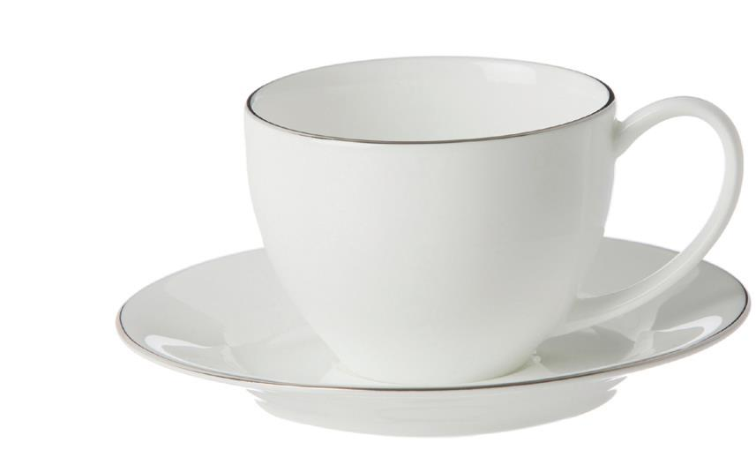
The average price per cup of Coffee
Trim Café
1 pack = HK$16.2
Has WellTrim® iG
Retail Brew Coffee
1 cup = HK$26

Slide 21


Slide 23

TLS® FLEX(ible) Program
A new program that can be followed in conjunction with any other TLS program except Detox or 21-day Challenge
For those who can stay on track and be able to incorporate 1-2 foods, not consistent with their TLS program weekly

Slide 24
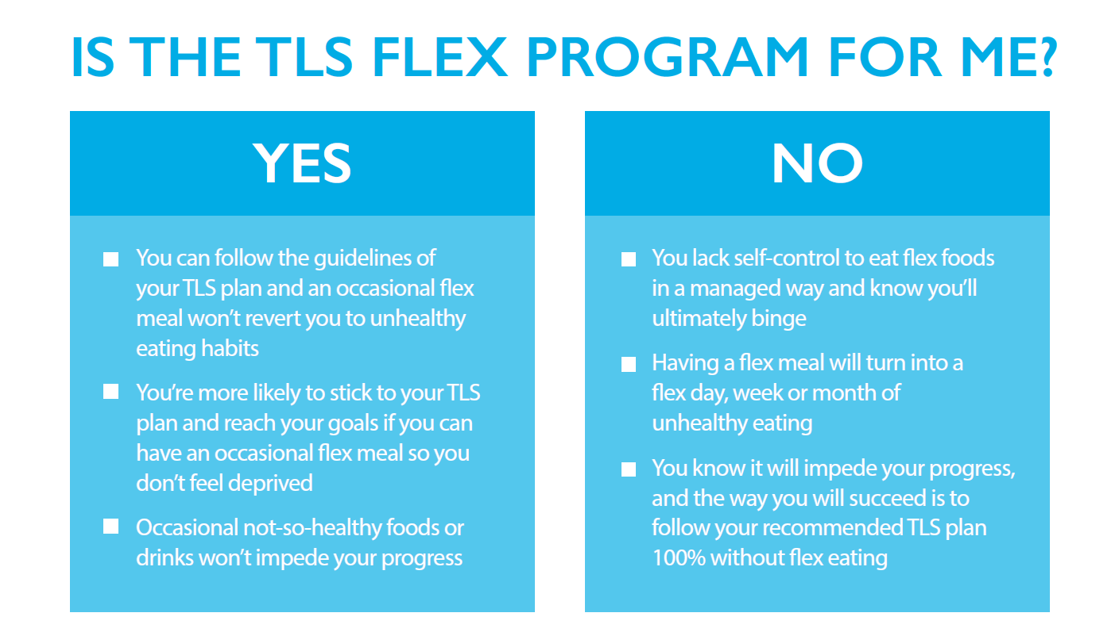

Slide 25
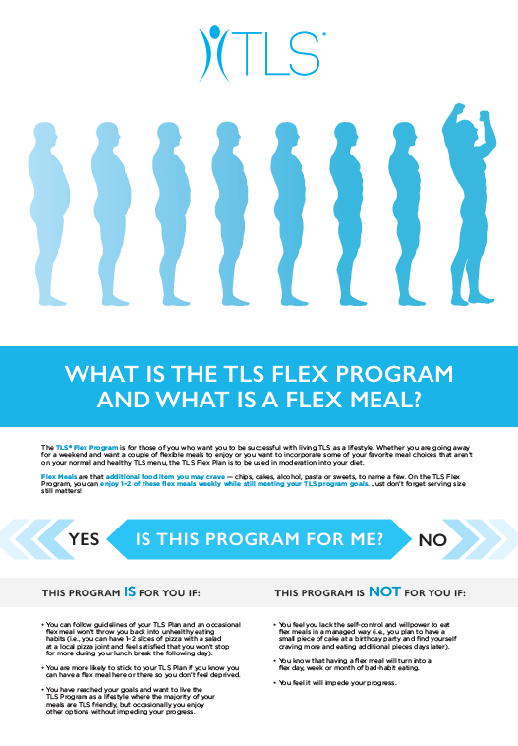
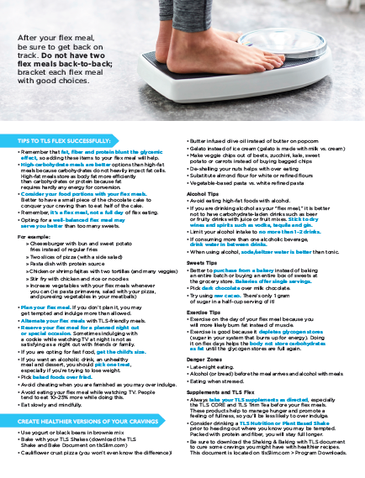

FLEX TOOLS

Slide 26
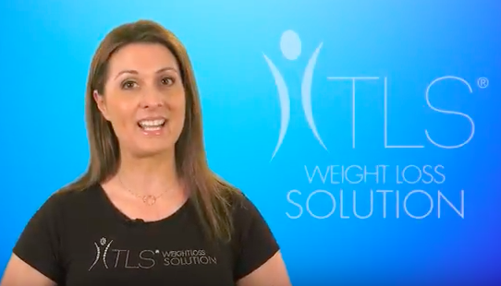

Video found on:
HK.TLSSLIM.COM > resources

